Slide 1
System Fundamentals
TOPIC 1.0 – SYSTEM FUNDAMENTALS
TOPIC 1
1.2.12 – 1.2.16 Human Interaction with the System

Slide 2

REVIEW REVIEW REVIEW REVIEW REVIEW REVIEW
THE WARM-UP QUESTION
Think of a recent new technology (cell phone, social media, AI)
List two social positives and negatives of this technology

Slide 3
REVIEW REVIEW REVIEW REVIEW REVIEW REVIEW
THE WARM-UP ANSWERS
Artificial Intelligence
Positives
Information readily available and easy to access
Less time consuming than finding search engine results
Negatives
Customer service jobs replaced with bots
Artists lose commissions because of AI art

Slide 4
TOPIC 1.2.12 – COMPUTER SYSTEM PARTS
Accessibility
Accessibility
The potential for a product or service to serve as many people as possible
High accessibility means the most people possible can use your product
Typically associated with the ability for people with disabilities to use a product
Visually Impairment
Input: Braille input devices
Output: Speech to text devices, color changing options (colorblind mode)
Hearing Impairment
Output: Visual effects instead of sound, subtitles
Learning Disabilities
Apps requiring participation, multi-sensory experiences

Slide 5
TOPIC 1.2.14 – COMPUTER SYSTEM PARTS
Accessibility
Mobility Impairment Inputs:
Left/Right-handed keyboards for amputees
Trackballs and computer gloves for reduced hand mobility
Larger keyed keyboards for those with reduced finger mobility
Morse code input devices for those with very limited mobility
Natural language processing (voice recognition)

Slide 6
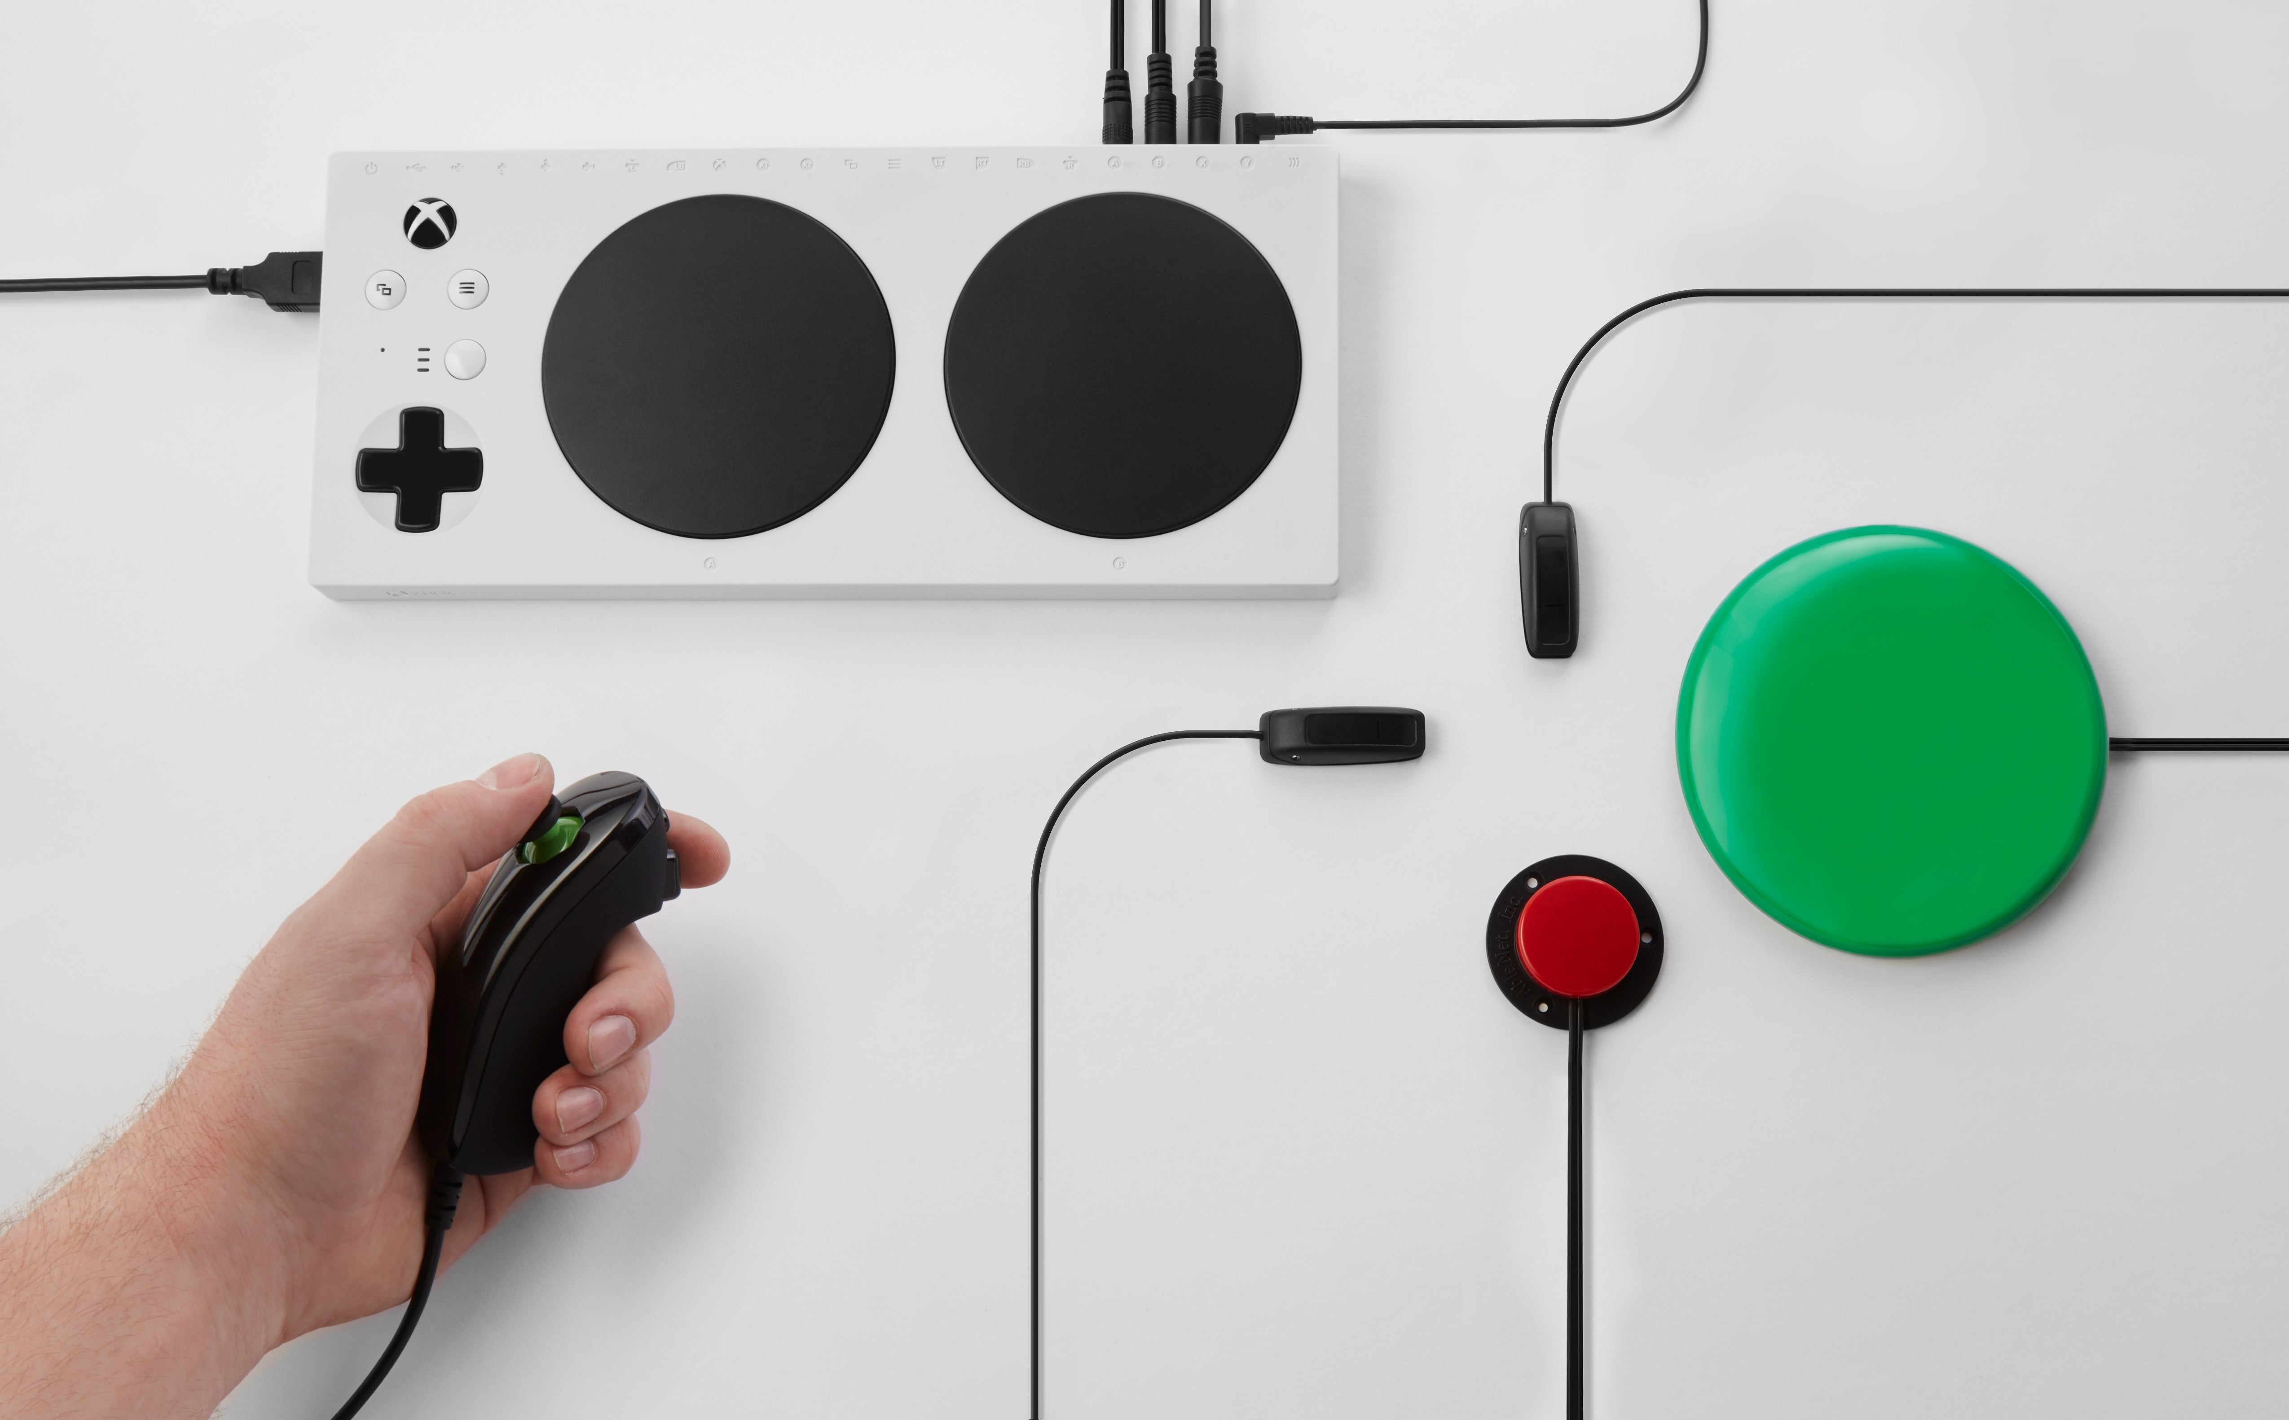
TOPIC 1.2.12 – COMPUTER SYSTEM PARTS
GREAT Accessibility
Xbox Adaptive Controller

Slide 7
TOPIC 1.2.12 – COMPUTER SYSTEM PARTS
USABILITY & Ergonomics
Usability
The ability for a product or service to meet user goals
Effectiveness, efficiency, satisfaction with product in specific use case
Ergonomics
Comfort of use and ease of use
Keyboards that are comfortable to type on
Chairs that have back support
Wrist rests

Slide 8
TOPIC 1.2.12 – COMPUTER SYSTEM PARTS
usability
8-point test for device usability
Complexity/Simplicity: Amount of effort to find a solution or get a result.
Effectiveness: Comparison of user performance against a predefined level.
Efficiency: Task completion time after the initial adjusting period
Error: Number of errors, type of errors and time needed to recover from errors.
Learnability: Time used to accomplish tasks on the first PPN!‘ use.
Memorability: Time, number of button clicks, pages, and steps used by users when they return to the device after a period of not using it.
Readability/Comprehensibility: Reading speed.
Satisfaction: Attitude of users toward applications after using them (if they like it)

Slide 9
TOPIC 1.2.12 – COMPUTER SYSTEM PARTS
usability
Potential problems for a train ticket purchasing system
Complexity/Simplicity: Unclear instructions, lack of built-in help
Effectiveness: Doesn’t abide by international standards
Efficiency: Complicated site makes users take unnecessary actions
Error: The user books too many tickets and has to restart the whole booking process
Learnability: Site is complex and takes time to learn to navigate
Memorability: Because of complexity, it may take users time to remember how to use it
Readability/Comprehensibility: Low contrast between background color and text color
Satisfaction: Customers sad because system BAD

Slide 10
TOPIC 1.2.13 – COMPUTER SYSTEM PARTS
usability
Examples of usability problems:
Game consoles
Some portable game consoles have relatively small screens.
Buttons may be too small.
Difficult to use outdoors (insufficient brightness).
Short battery life.
PCs:
Excessive keyboard use may lead to RSI (Repetitive Strain Injury) syndrome.
Excessive use of a large, bright screen may cause eyesight problems or tire the eyes.
Poor room lighting conditions may lead to distracting reflections on the screen.
The mouse of a PC is designed for right—handed people, making its use difficult for left-handed people.

Slide 11
TOPIC 1.2.13 – COMPUTER SYSTEM PARTS
usability
Examples of usability problems:
Game consoles
Some portable game consoles have relatively small screens.
Buttons may be too small.
Difficult to use outdoors (insufficient brightness).
Short battery life.
PCs:
Excessive keyboard use may lead to RSI (Repetitive Strain Injury) syndrome.
Excessive use of a large, bright screen may cause eyesight problems or tire the eyes.
Poor room lighting conditions may lead to distracting reflections on the screen.
The mouse of a PC is designed for right—handed people, making its use difficult for left-handed people.

Slide 12
TOPIC 1.2.13 – COMPUTER SYSTEM PARTS
Usability DISCUSSION
Tablets tend to have small keyboards that are hard to type on
Is having a handwriting recognition system convenient for tablets?

Slide 13
TOPIC 1.2.15 – COMPUTER SYSTEM PARTS
Usability EXERCISE
What is a potential usability concern for each of the following system types? Which of the 8 categories does it fall under?
Online Payroll
Scheduling
Voice Recognition System

Slide 14
TOPIC 1.2.16 – COMPUTER SYSTEM PARTS
Moral implications
We have opportunities to do a great deal of good and a great deal of harm with machines
AI allows us to imagine new ideas
AI also allows us to create convincing deepfakes of real people
Dependence on technology makes it more difficult for low-income people to get ahead in the world
All actions have consequences

Slide 15
TOPIC 1.2.16 – COMPUTER SYSTEM PARTS
Current SYSTEMS research
Find a news story from the past 2 years about a new technology
List 2 benefits of that new technology
List 2 downsides of that new technology
These can be social, technical, or any category
Write this out so you can tell the rest of us about what you’ve found
Time: 20 Minutes

Slide 16

VOCAB TO REMEMBER
Accessibility
Usability
Ergonomics

